Slide 1
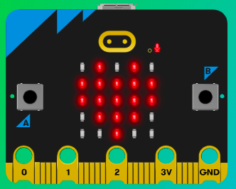
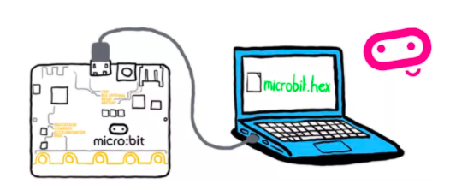
MicroMakers!
KIDS’ MAKER CLUB OF WASHINGTON, DC
Meet Up #11
And Now for Something Completely Different…

Slide 2

RECAP!
Magnetometer, Accelerometer, Light Sensor, Temperature Sensor
Micro:bit Inputs and Outputs
Scratch Inputs and Outputs
Compass Degrees
X-Y Coordinate Plane
If, Then, Else
Variable
Loop
Sprite
Bells and Whistles
Notes:
LEDs, Buttons, Light Sensor

Slide 3
SCRATCH!
The First Drag + Drop Visual Coding Language for Kids

Slide 4
RECAP: Chase Game
In your chase game, how did you use the following programming elements?
Variable
Loop
If / Then Statement
Math Operation

Slide 5
CLOSE YOUR COMPUTERS!
We know you can’t wait to get started…but listen up!

Slide 6
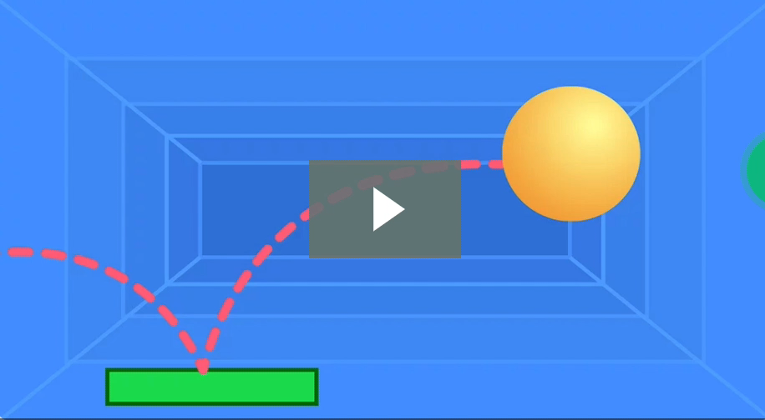
Step 1: The Project Pong!
What is it?
Create a paddle / ball game for your friends to play.
What do I need?
Scratch coding environment.

Slide 7
Step 2: How Does it Work (Part I)?
Add backdrop
Add ball sprite
Make ball sprite bounce around when the program starts
Add a paddle
Create mechanism to move paddle (with keyboard, mouse, etc.)
Select ball sprite and add code to bounce ball off of the paddle.
Stop for a CODE CHECK!

Slide 8
Step 2: How Does it Work (Part II)?
Add a score variable
Add a ‘change score’ block inside of your ‘touching paddle’ block
Reset score to zero when starting the program
Add a line sprite and place at bottom of screen
If ball touches line sprite, game over (“stop ‘all’”)
Test and debug!

Slide 9


Step 2: How Does it Work (Part III)?
Scratch is a super fun coding platform, with which you can do lots of neat things. PLEASE DO NOT GET DISTRACTED and try to finish this assignment, as given.
A good coder keeps their eye on the prize and completes a program’s key functions before adding what we call bells and whistles.

Slide 10
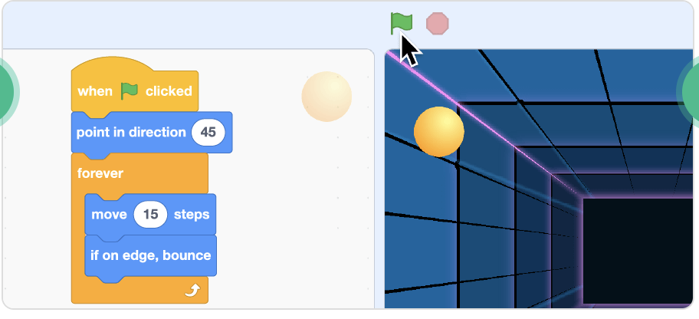
Step 3: Read It and Code It

Slide 11
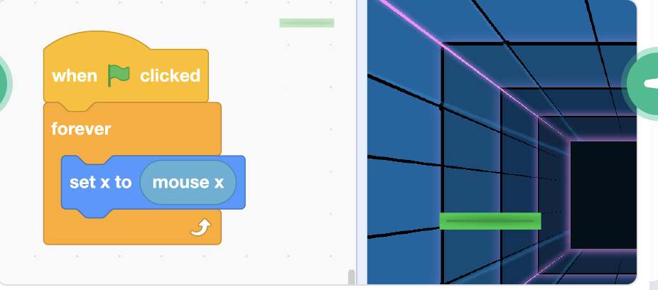
Step 3: Read It and Code It

Slide 12
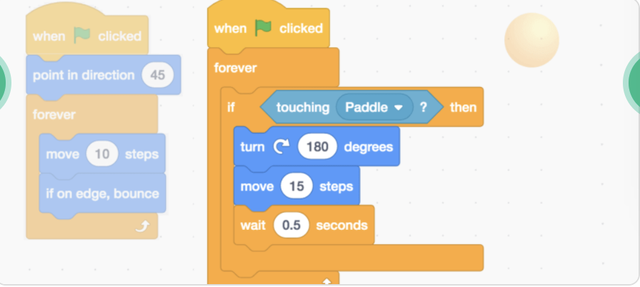
Step 3: Read It and Code It

Slide 13
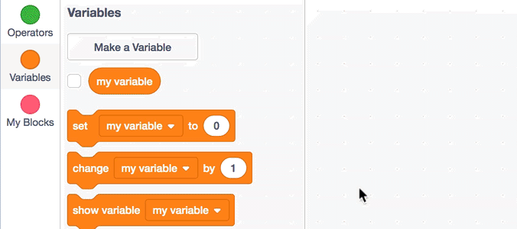
Step 3: Read It and Code It

Slide 14
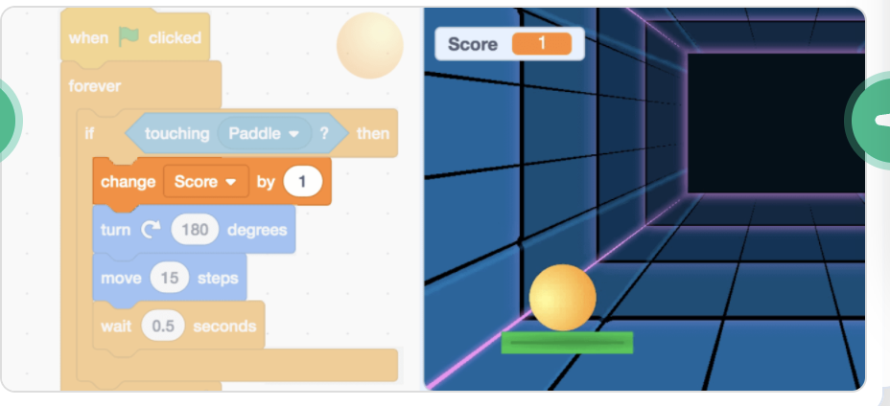
Step 3: Read It and Code It

Slide 15
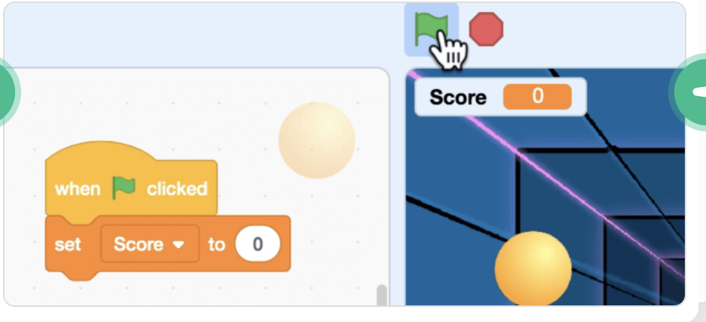
Step 3: Read It and Code It

Slide 16
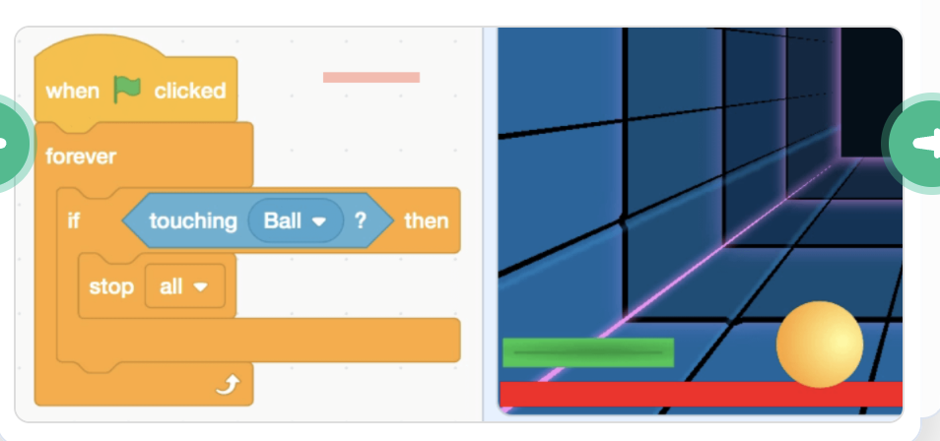
Step 3: Read It and Code It

Slide 17
Step 4: Share Your Creation!

Slide 18
Step 5: Improve It
Ask your clubmates for recommendations to improve your program and implement one of them.
Add your BELLS AND WHISTLES!!!

Slide 19
ONE MORE THING….
You will love this.

Slide 20
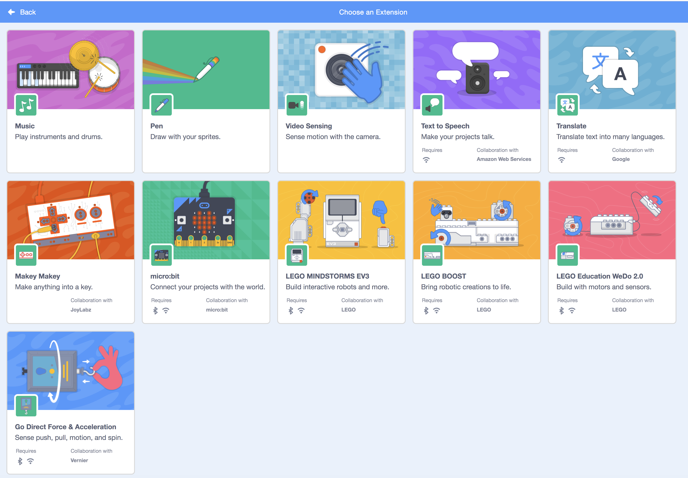

Slide 21
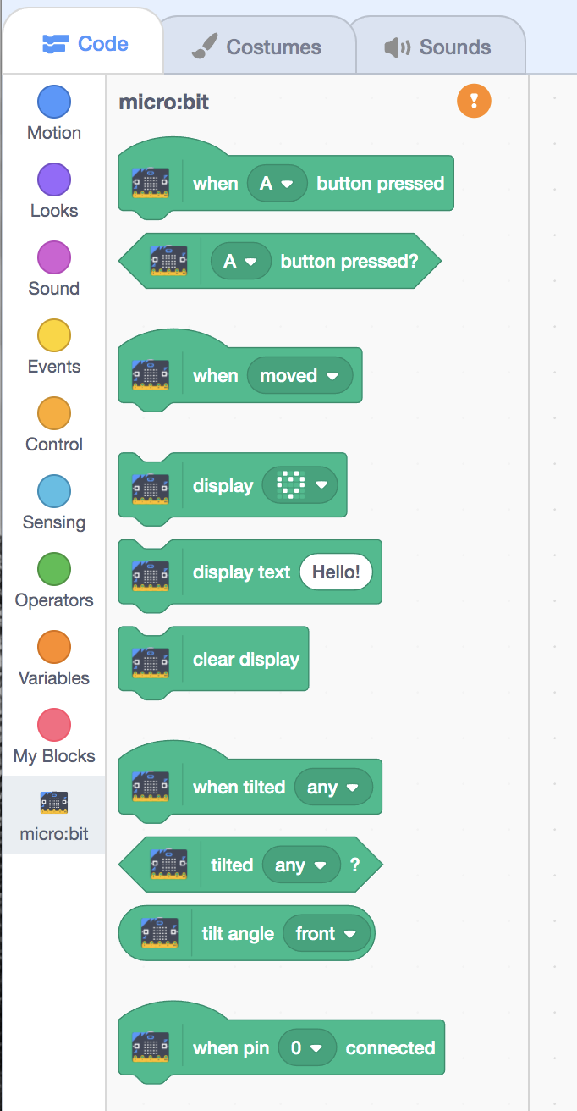

Slide 22
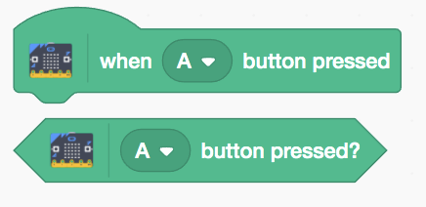

Slide 23
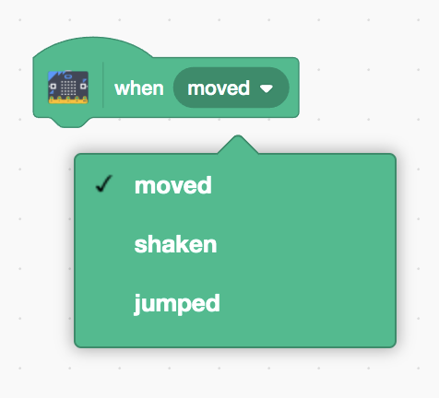

Slide 24
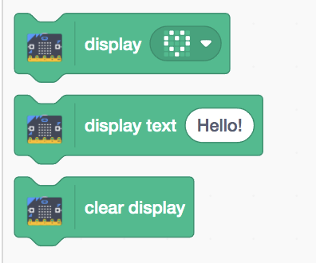

Slide 25
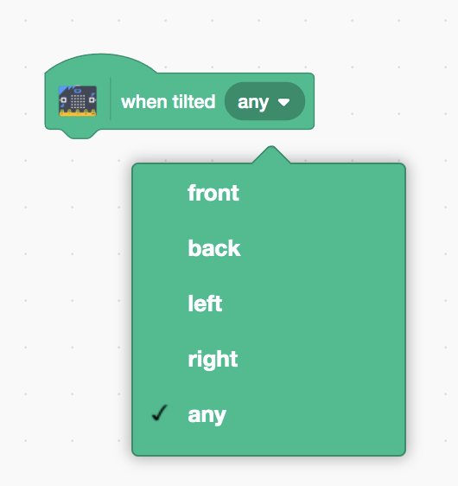

Slide 26
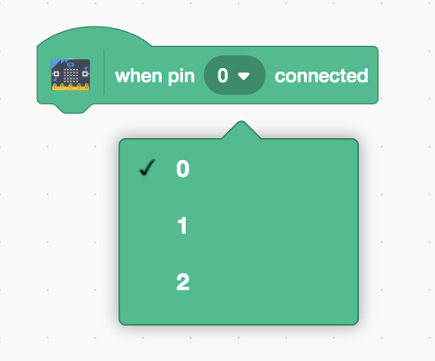

Slide 27
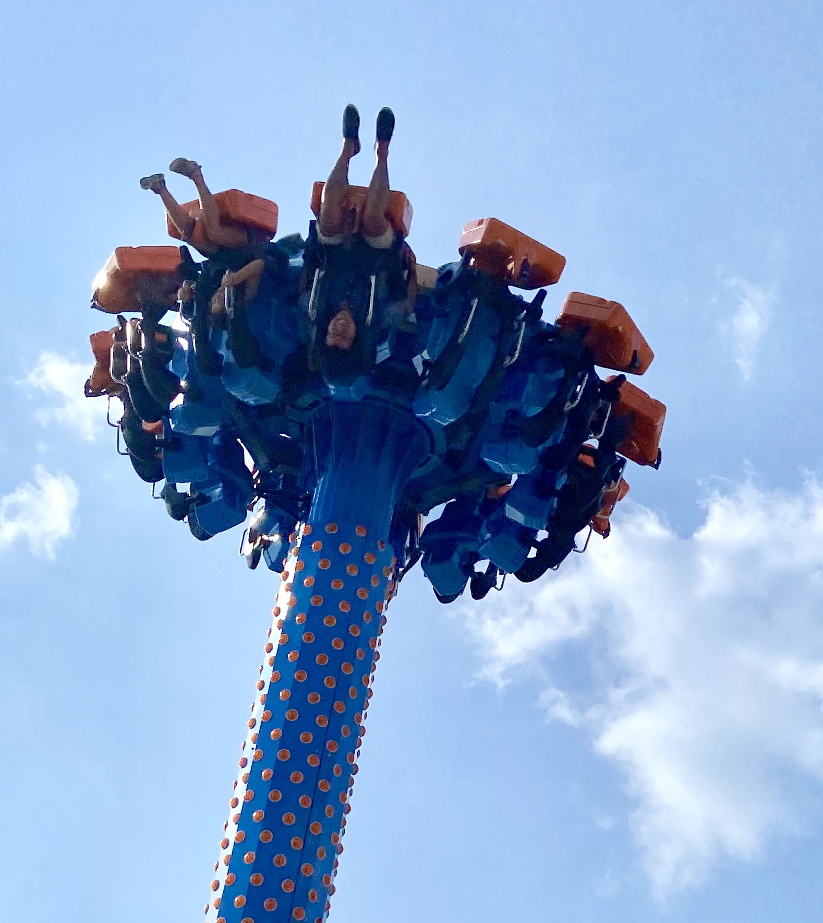
SKILL BADGE
Video Game System
YOUR MISSION
Make a Scratch game that can be controlled with your Micro:bit (!)

Slide 28
TIME TO PUT AWAY OUR COMPUTERS!
Neat and tidy, please!
Let’s leave this beautiful room as lovely as we found it!

Slide 29

UNTIL NEXT TIME….
MicroMakers!
Slides and Script: Holly Krambeck (learningpython64@gmail.com)
Project Videos, Images, and Text:
https://scratch.mit.edu/

